Slide 1
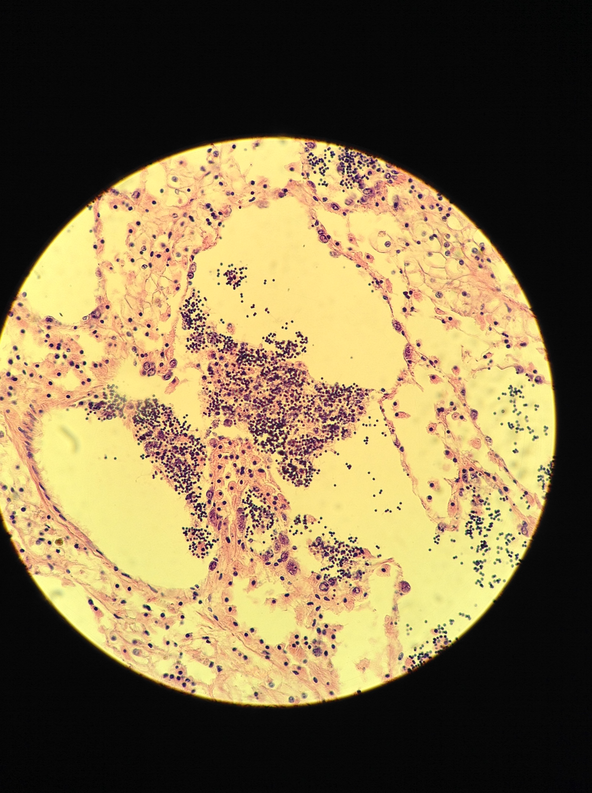
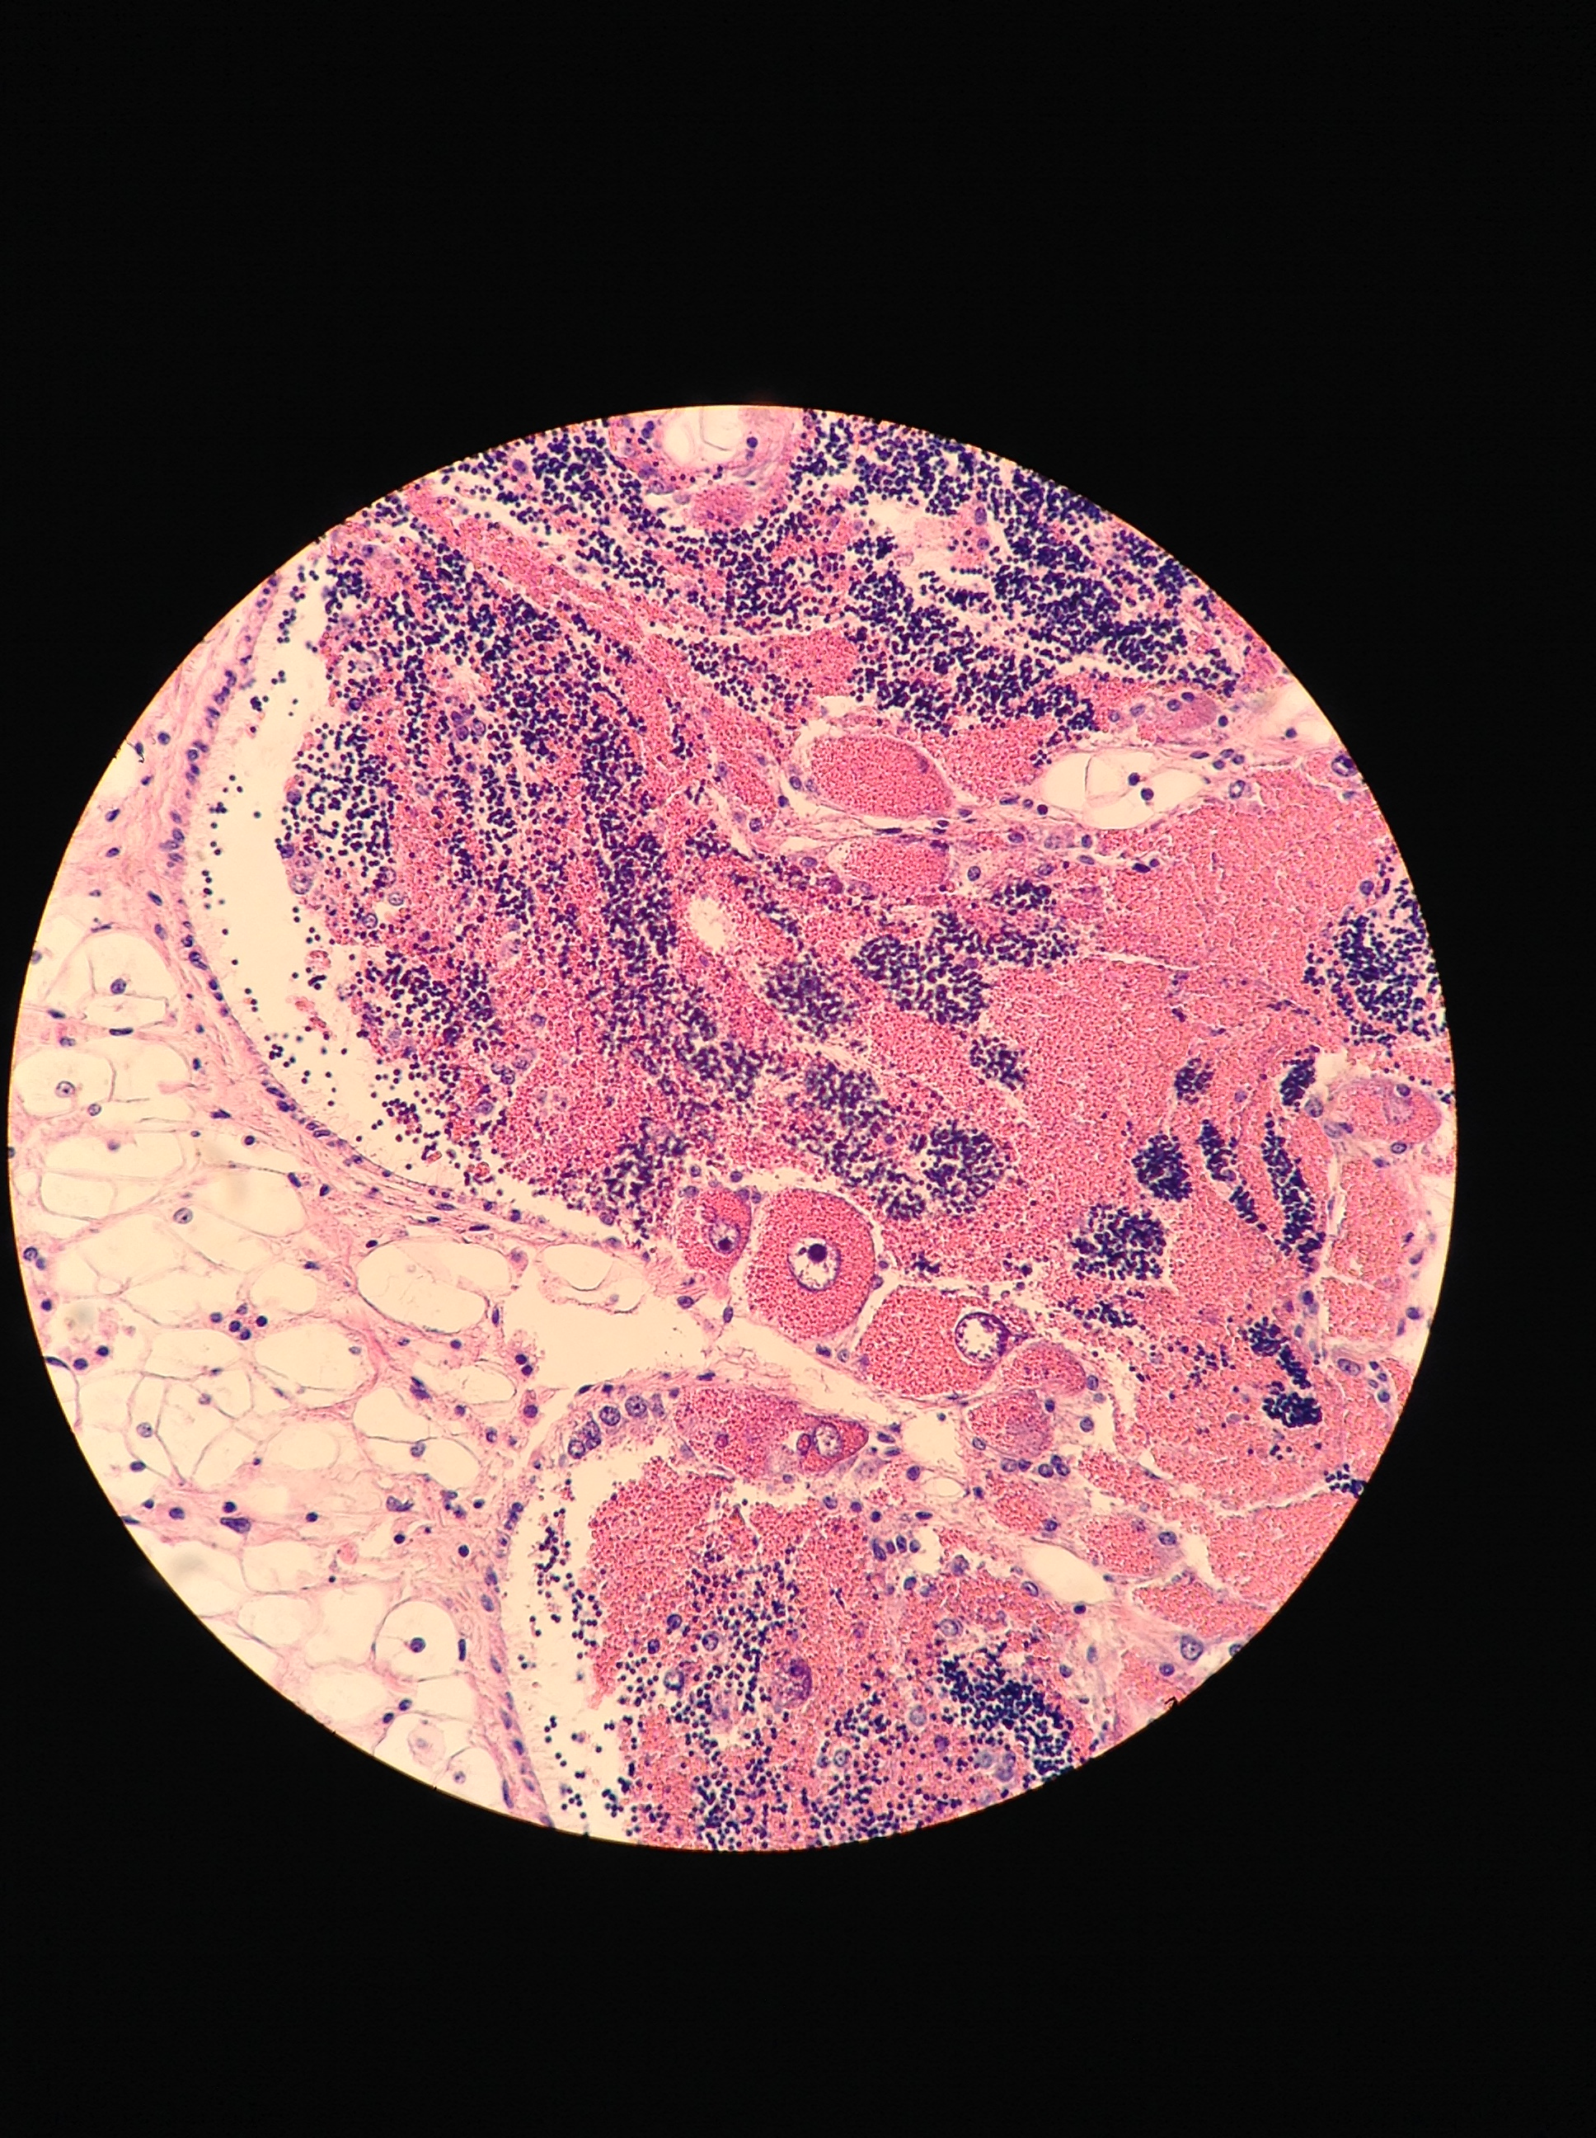
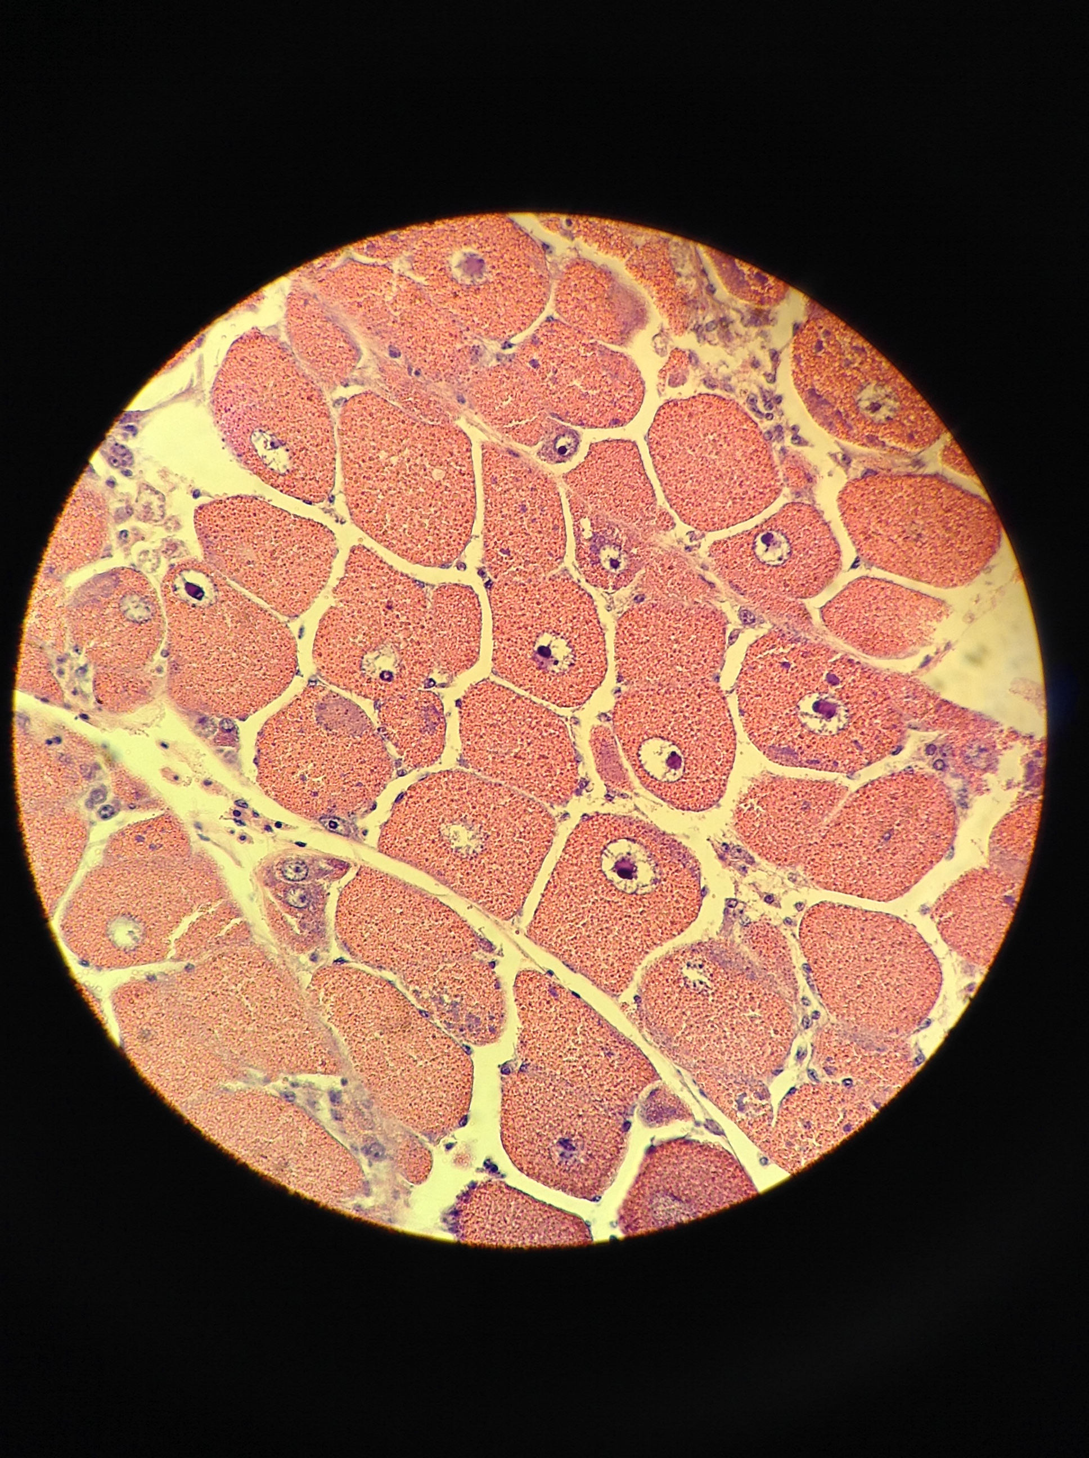
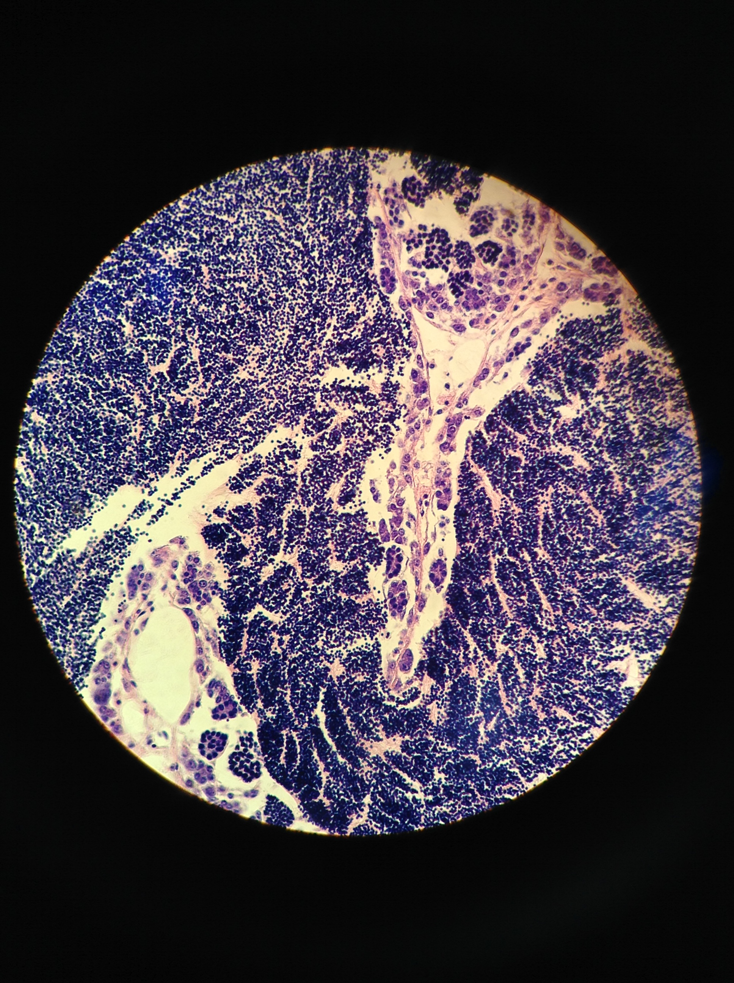
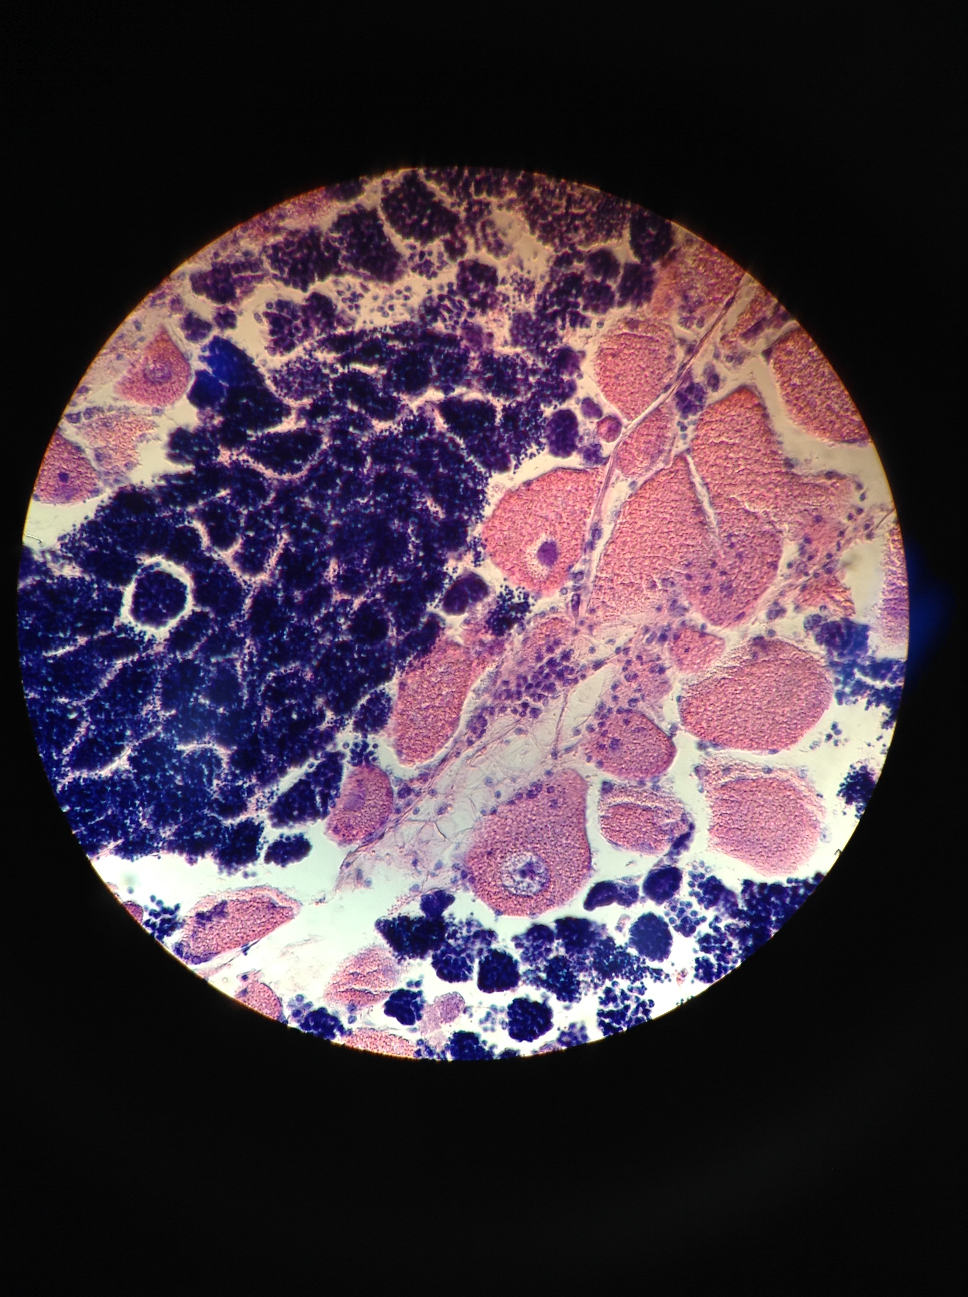
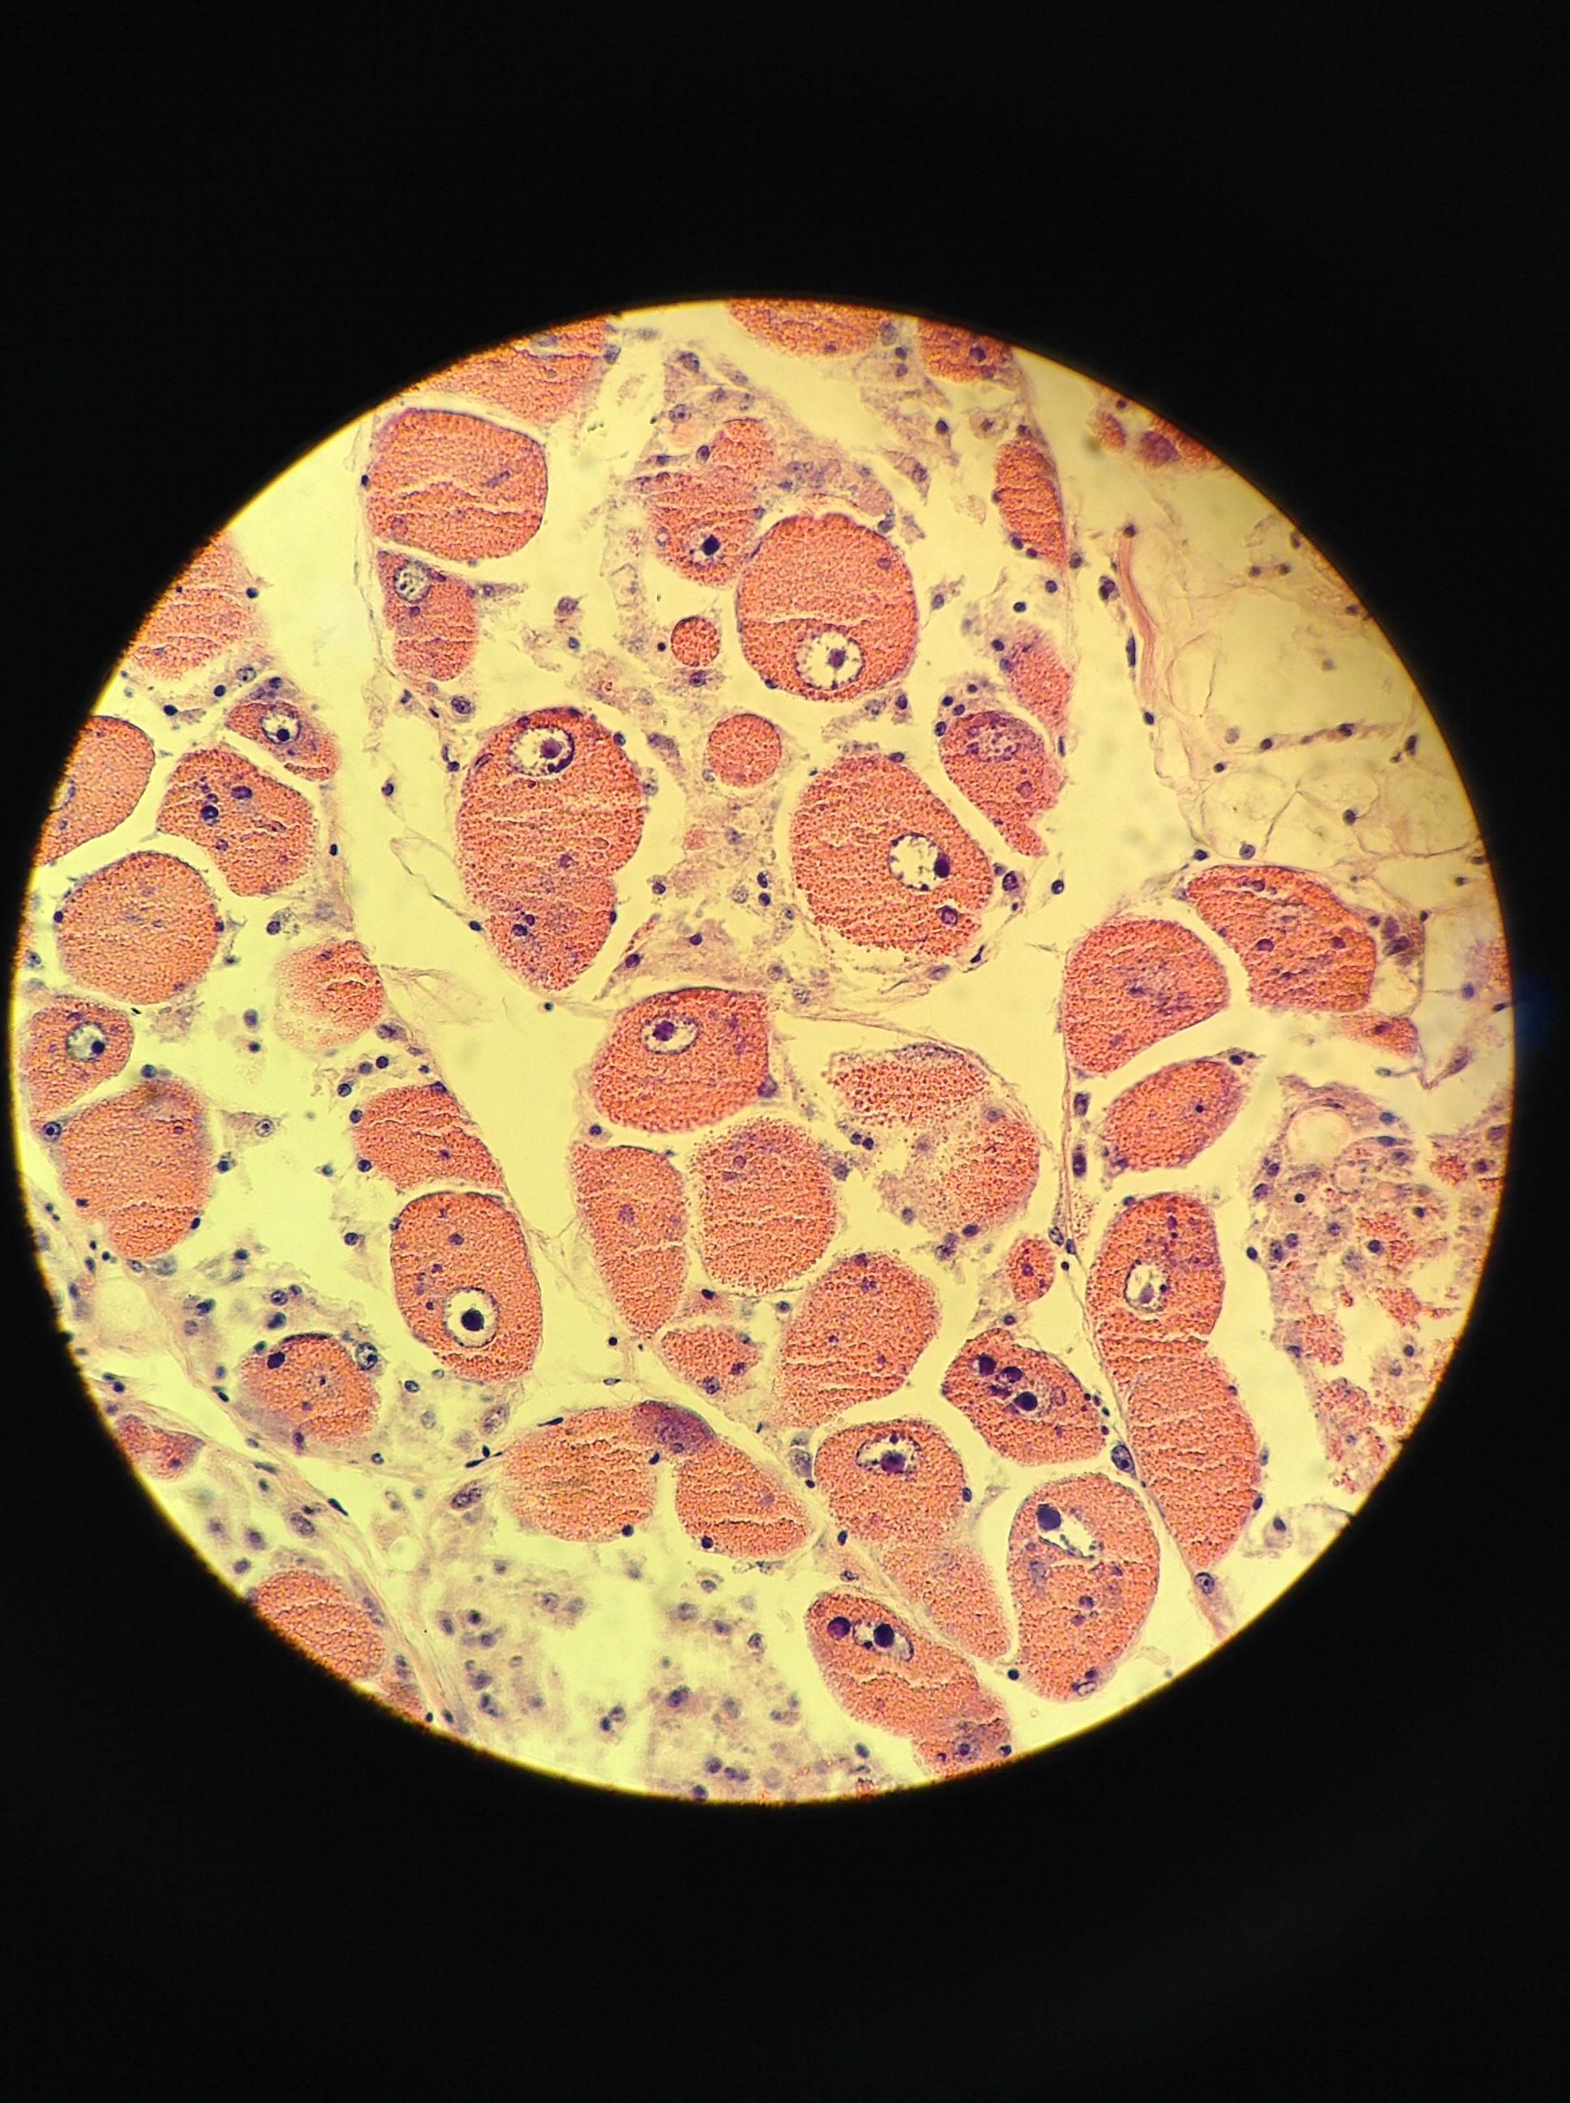
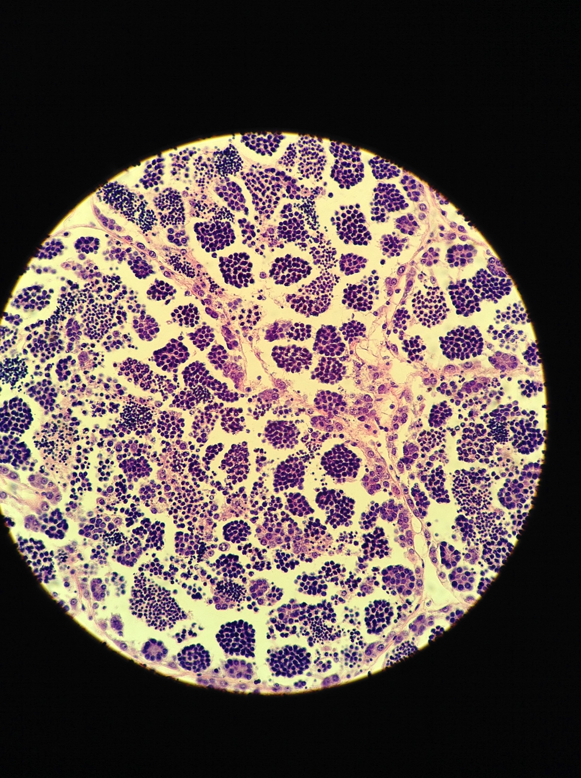
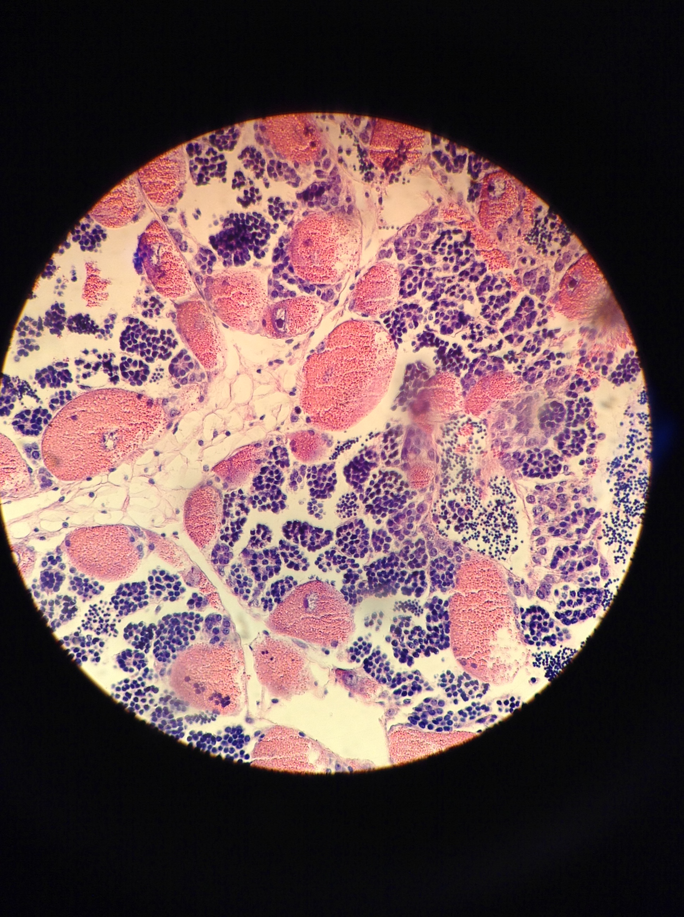
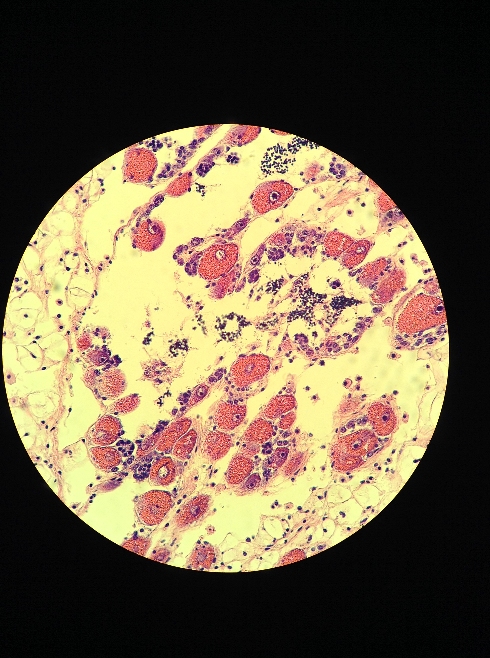
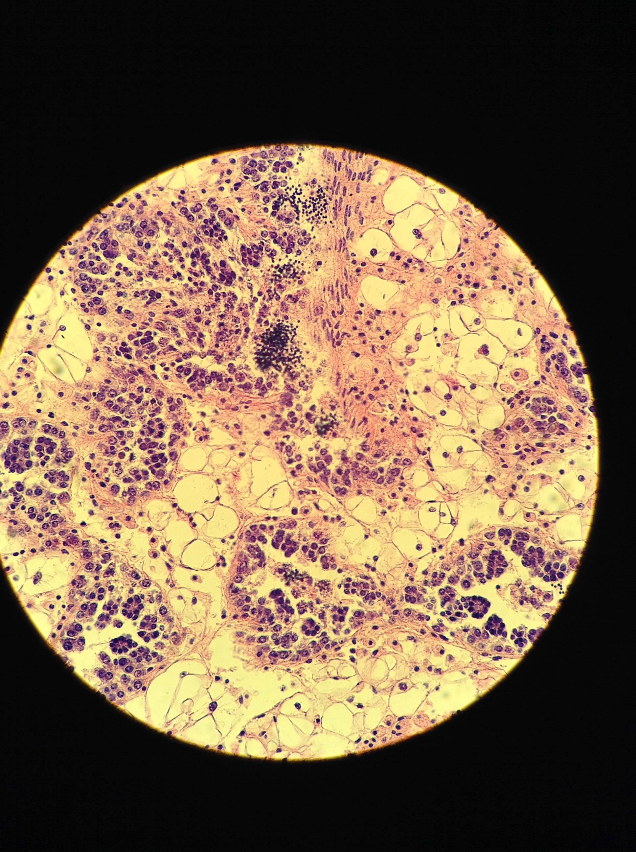
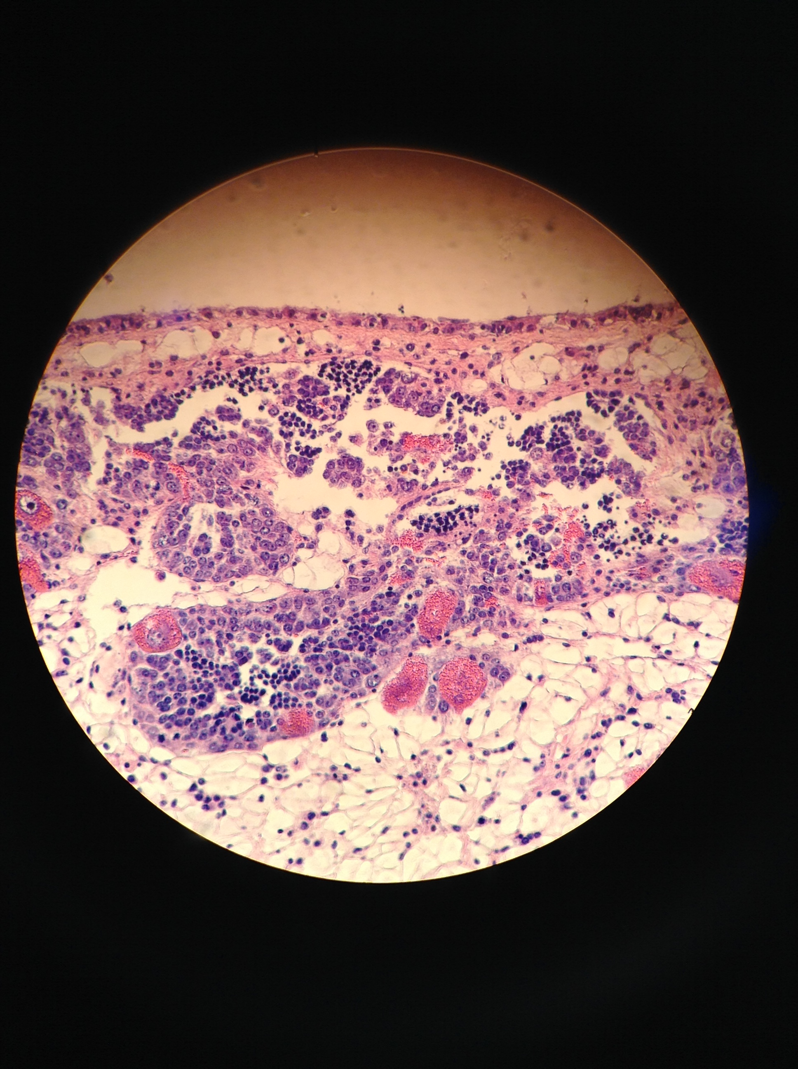
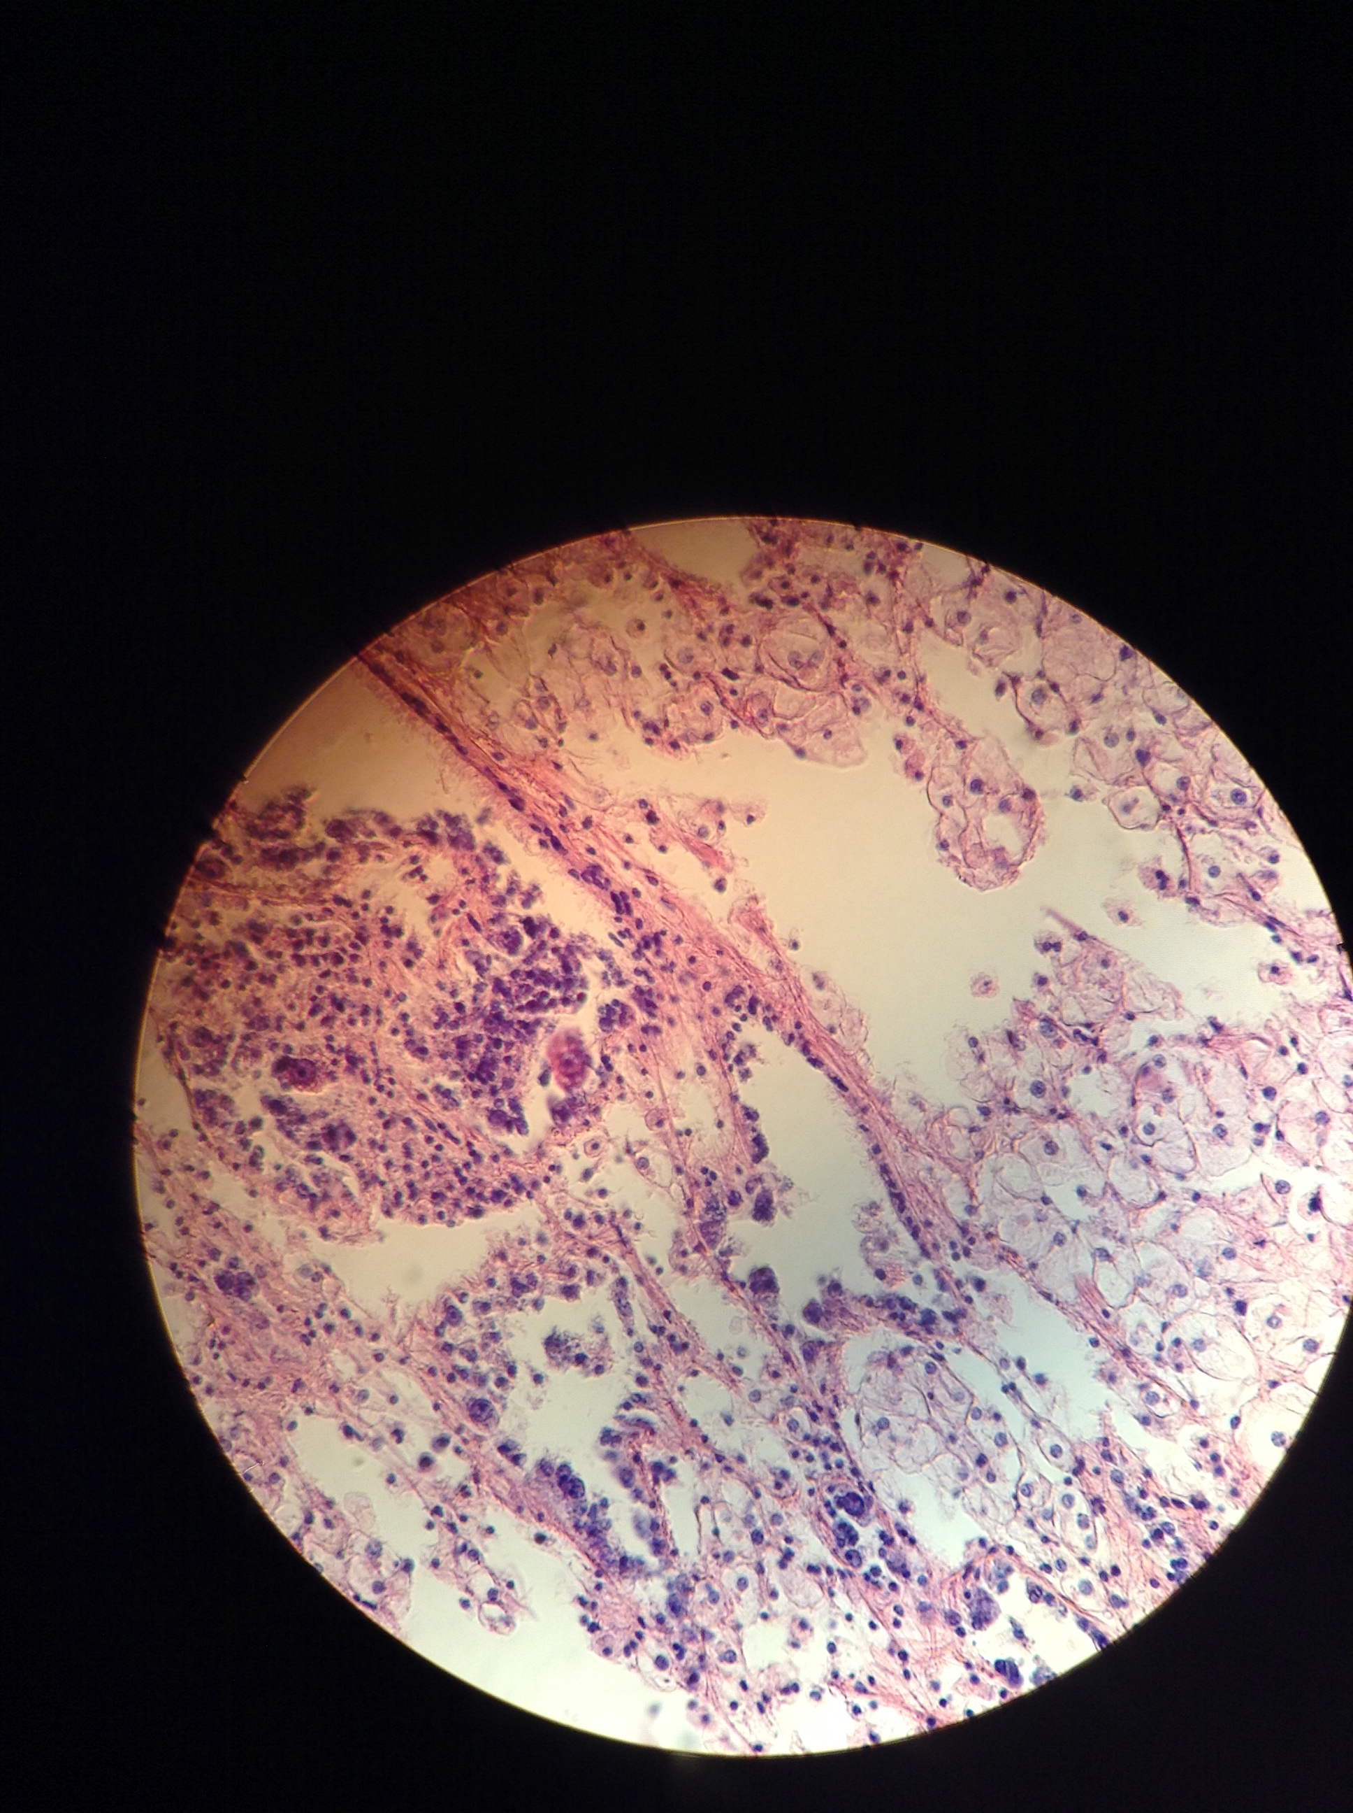
Female
Male
Hermaphroditic
4
None present
3
2
1
0
Notes:
Stage 4 male: NF6-#7
Stage 4 herm: NF6-#6
Stage 0: SN6-31

Slide 6
Dabob
Fidalgo
Oyster F2
Oyster F1
Dabob
Fidalgo
Oyster F1
Oyster F2

Slide 7
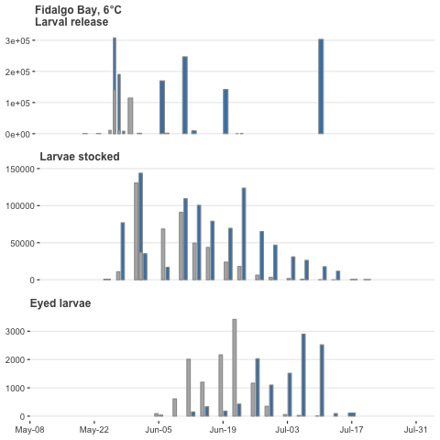
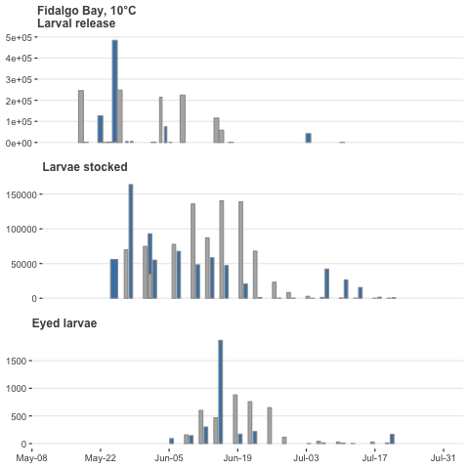
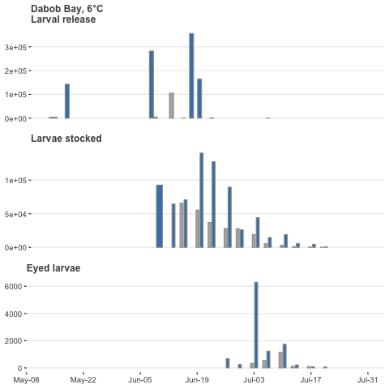
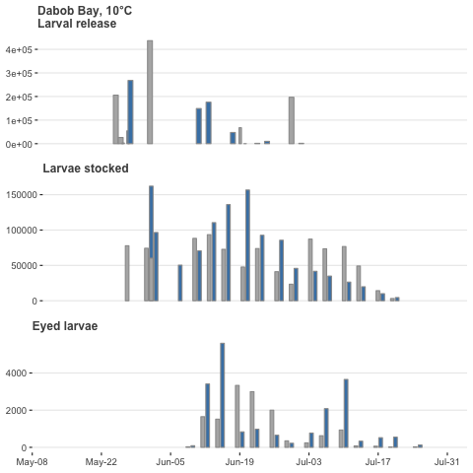
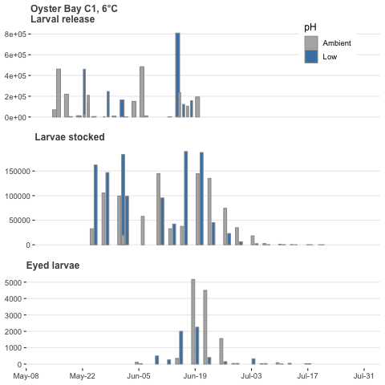
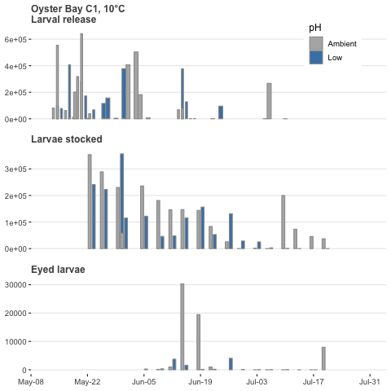
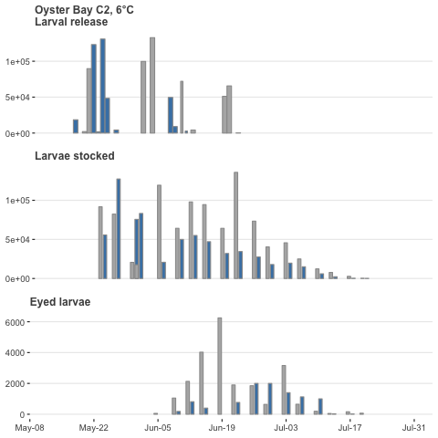
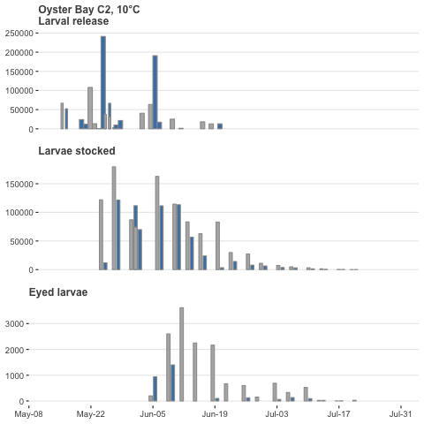

Slide 17
Cumulative larvae released per broodstock
43
52
65
55

Slide 18
Cohort
Cold
6°C
High pCO₂
3045 µatm
Warm
10°C
High pCO₂
3045 µatm
Temperature exposure
Dec. 6 – Feb. 5, 2017
pCO₂ exposure
Feb. 15 – Apr. 8, 2017
Ambient pCO₂ 841 µtam
Ambient pCO₂ 841 µtam
Conditioning, spawning began Apr. 11
First larvae observed May 11
Last larvae collected Jul. 10, 2017
pCO₂ exposure
Feb. 15 – Apr. 8, 2018

Slide 19
b
a
a
a
ab
ab
b
b

